Slide 1




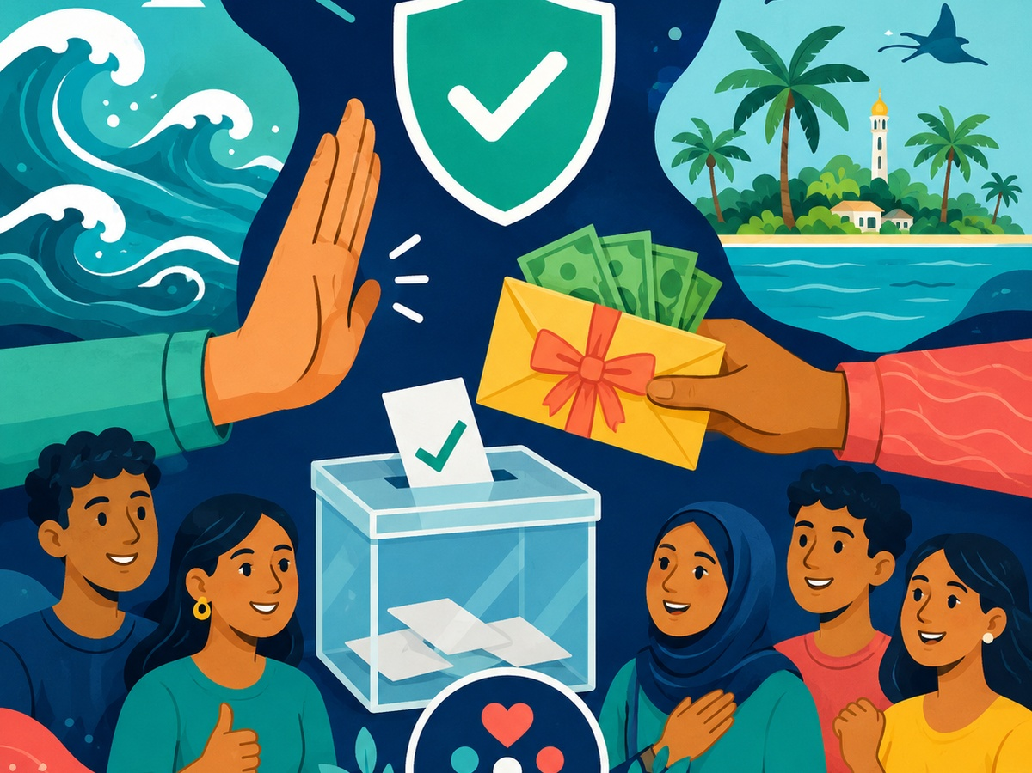
Implemented by:
In partnership with:
Women & Democracy
QUIZ 3
Vote Buying Awareness
My Vote Is Not for Sale
Promote free choice, accountability, and clean elections by rejecting vote buying.
#rights
#verify
#vote
#youth
Maldives Election Awareness
Swipe-style PPT deck for youth civic education sessions
W&D Election Awareness Hub • Quiz 3
1

Slide 2
Vote Buying Awareness
Implemented by:
In partnership with:
Women & Democracy
How to play
A quick, interactive quiz designed for youth sessions, community forums, and website engagement.
1
Use this quiz in community forums, youth sessions, or campaign ethics discussions.
2
Reflect on how vote buying affects communities beyond election day.
8–10
Excellent
3
Encourage responsible reporting rather than online rumour-sharing.
5–7
Good effort
0–4
Keep learning
Tip: encourage discussion after each answer.
W&D Election Awareness Hub • Quiz 3
2

Slide 3
My Vote Is Not for Sale
Implemented by:
In partnership with:
Women & Democracy
Q1
What is vote buying?
A
Offering money, gifts, services or promises to influence a person’s vote
B
Reading a candidate manifesto
C
Attending a debate
D
Watching election news
A free vote cannot be bought.
Maldives context
Discuss with your group
Vote buying can include money, gifts, services, or promises intended to influence a vote.
W&D Election Awareness Hub • Quiz 3
3

Slide 4
My Vote Is Not for Sale
Implemented by:
In partnership with:
Women & Democracy
Q2
Why is vote buying harmful?
A
It weakens free choice and accountability
B
It improves democracy
C
It helps voters understand policies
D
It makes candidates more honest
A free vote cannot be bought.
Maldives context
Discuss with your group
When votes are bought, public accountability is weakened and citizens lose influence after election day.
W&D Election Awareness Hub • Quiz 3
4

Slide 5
My Vote Is Not for Sale
Implemented by:
In partnership with:
Women & Democracy
Q3
If someone offers you money or a service in exchange for your vote, what should you remember?
A
Your vote is secret and should be free
B
You must vote for them
C
They can check your ballot
D
You must prove your vote
A free vote cannot be bought.
Maldives context
Discuss with your group
The secrecy of the ballot protects voters from pressure and improper influence.
W&D Election Awareness Hub • Quiz 3
5

Slide 6
My Vote Is Not for Sale
Implemented by:
In partnership with:
Women & Democracy
Q4
Is intimidating a voter to influence their vote allowed?
A
Yes
B
No
C
Only during campaign season
D
Only by senior people
A free vote cannot be bought.
Maldives context
Discuss with your group
Intimidating voters is harmful to free participation and can amount to an election-related offence.
W&D Election Awareness Hub • Quiz 3
6

Slide 7
My Vote Is Not for Sale
Implemented by:
In partnership with:
Women & Democracy
Q5
Can someone lawfully ask you to show proof of who you voted for?
A
Yes, always
B
No, your vote is secret
C
Only candidates can ask
D
Only employers can ask
A free vote cannot be bought.
Maldives context
Discuss with your group
No one should require proof of how you voted. Your vote is secret.
W&D Election Awareness Hub • Quiz 3
7

Slide 8
My Vote Is Not for Sale
Implemented by:
In partnership with:
Women & Democracy
Q6
Which is a better reason to vote for a candidate?
A
Their policies, record, values and plans
B
The biggest gift offered
C
Pressure from others
D
A rumour about another candidate
A free vote cannot be bought.
Maldives context
Discuss with your group
Voters should choose based on policies, record, values, and plans—not gifts or pressure.
W&D Election Awareness Hub • Quiz 3
8

Slide 9
My Vote Is Not for Sale
Implemented by:
In partnership with:
Women & Democracy
Q7
What should communities discourage during elections?
A
Peaceful debate
B
Vote buying and intimidation
C
Checking official sources
D
Youth participation
A free vote cannot be bought.
Maldives context
Discuss with your group
Clean elections depend on communities rejecting bribery, intimidation, and coercion.
W&D Election Awareness Hub • Quiz 3
9

Slide 10
My Vote Is Not for Sale
Implemented by:
In partnership with:
Women & Democracy
Q8
If you hear a serious allegation of vote buying, what should you avoid?
A
Using official complaint or reporting channels
B
Spreading unverified names and accusations online
C
Keeping evidence safely if available
D
Seeking guidance from relevant authorities
A free vote cannot be bought.
Maldives context
Discuss with your group
Serious allegations should be handled responsibly through proper channels, not rumours.
W&D Election Awareness Hub • Quiz 3
10

Slide 11
My Vote Is Not for Sale
Implemented by:
In partnership with:
Women & Democracy
Q9
Who can raise election-related complaints under the Elections (General) Act?
A
Only candidates
B
Only political parties
C
Voters, candidates, political parties, approved observers/monitors and election officials
D
No one
A free vote cannot be bought.
Maldives context
Discuss with your group
Election-related complaints may be raised by authorised stakeholders under the Elections (General) Act.
W&D Election Awareness Hub • Quiz 3
11

Slide 12
My Vote Is Not for Sale
Implemented by:
In partnership with:
Women & Democracy
Q10
Which message best supports clean elections?
A
My vote is not for sale
B
Gifts decide my vote
C
I should vote under pressure
D
I must show my ballot
A free vote cannot be bought.
Maldives context
Discuss with your group
“My vote is not for sale” reinforces the value of free and fair participation.
W&D Election Awareness Hub • Quiz 3
12

Slide 13
Vote Buying Awareness
Implemented by:
In partnership with:
Women & Democracy
Answer Key
Reveal answers after participants complete the quiz.
Q1
Q2
Q3
Q4
Q5
A
A
A
B
B
Q6
Q7
Q8
Q9
Q10
A
B
B
C
A
8–10: Strong awareness
5–7: Review key points
Facilitator prompt: Ask participants which answer surprised them most and why.
0–4: Keep learning
W&D Election Awareness Hub • Quiz 3
13

Slide 14
Vote Buying Awareness
Implemented by:
In partnership with:
Women & Democracy
Legal references
Use these references to keep the quiz grounded in Maldivian election law and official civic education sources.
✓
Elections (General) Act: bribery, intimidation, and complaints
✓
Constitution of the Maldives: secret ballot and political participation
✓
Community civic education messaging on free choice and accountability
Know your rights. Check the source.
Disclaimer: This is for civic and voter education only. For official election dates, voter registration, polling locations, candidate lists, complaints, and results, refer to the Elections Commission of Maldives.
W&D Election Awareness Hub • Quiz 3
14

Slide 15
Implemented by:
In partnership with:
Women & Democracy
End of Quiz
Thank you for participating
Keep checking official sources, protect your vote, and help your community participate freely and responsibly.
Check before you share
My vote matters
W&D Election Awareness Hub
W&D Election Awareness Hub • Quiz 3
15

