Slide 1




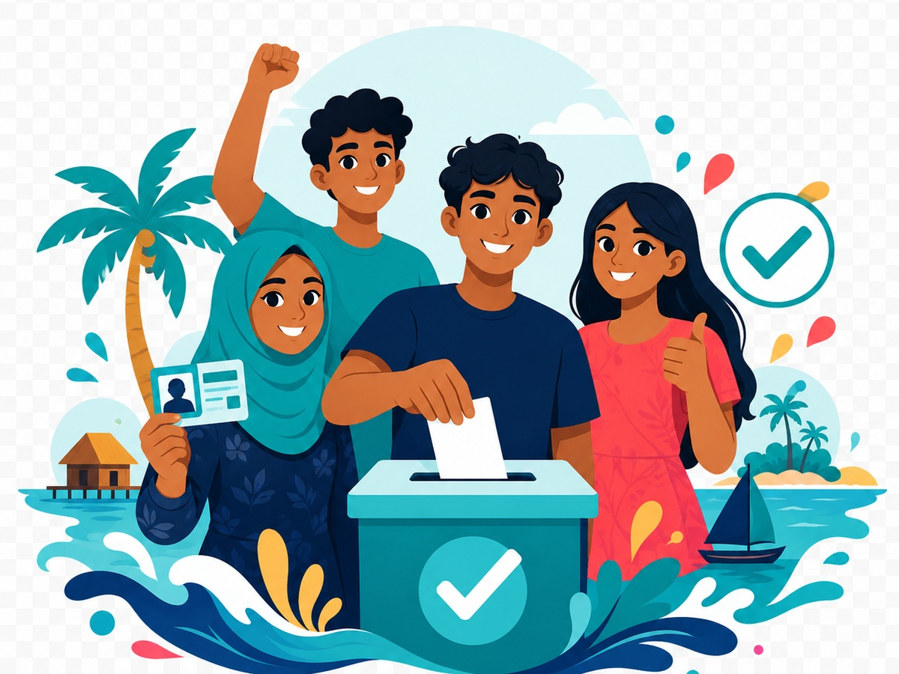
Implemented by:
In partnership with:
Women & Democracy
QUIZ 4
Election Day Readiness
Election Day in the Maldives
Support peaceful, informed, and confident participation on election day.
#rights
#verify
#vote
#youth
Maldives Election Awareness
Swipe-style PPT deck for youth civic education sessions
W&D Election Awareness Hub • Quiz 4
1

Slide 2
Election Day Readiness
Implemented by:
In partnership with:
Women & Democracy
How to play
A quick, interactive quiz designed for youth sessions, community forums, and website engagement.
1
Use this quiz before election day to help voters prepare practically.
2
Discuss what voters should do before arriving, inside the polling station, and after voting.
8–10
Excellent
3
Reinforce peaceful participation and respect for election procedures.
5–7
Good effort
0–4
Keep learning
Tip: encourage discussion after each answer.
W&D Election Awareness Hub • Quiz 4
2

Slide 3
Election Day in the Maldives
Implemented by:
In partnership with:
Women & Democracy
Q1
Before election day, what should a voter check?
A
Voter registration and polling/ballot box information
B
Only social media comments
C
Which rumour is most popular
D
Nothing
Prepare early. Vote peacefully.
Maldives context
Discuss with your group
Voters should verify registration and polling details early to avoid confusion.
W&D Election Awareness Hub • Quiz 4
3

Slide 4
Election Day in the Maldives
Implemented by:
In partnership with:
Women & Democracy
Q2
What should voters bring on election day?
A
The required identification document
B
Someone else’s ID
C
Campaign gifts
D
A screenshot of a rumour
Prepare early. Vote peacefully.
Maldives context
Discuss with your group
Voters should bring the identification document required by the Elections Commission.
W&D Election Awareness Hub • Quiz 4
4

Slide 5
Election Day in the Maldives
Implemented by:
In partnership with:
Women & Democracy
Q3
What should happen before a ballot box is used?
A
It should be handled according to official procedures
B
It should be opened privately by candidates
C
It should be hidden from voters
D
It should be filled before voting starts
Prepare early. Vote peacefully.
Maldives context
Discuss with your group
Ballot boxes must be prepared and checked according to official procedures.
W&D Election Awareness Hub • Quiz 4
5

Slide 6
Election Day in the Maldives
Implemented by:
In partnership with:
Women & Democracy
Q4
How should the voting booth be arranged?
A
So voters can mark ballots screened from observation by others
B
So everyone can see the ballot
C
So candidates can watch voters mark ballots
D
So voters must show their choice
Prepare early. Vote peacefully.
Maldives context
Discuss with your group
The voting booth must protect privacy so each person can vote independently and secretly.
W&D Election Awareness Hub • Quiz 4
6

Slide 7
Election Day in the Maldives
Implemented by:
In partnership with:
Women & Democracy
Q5
Can another person mark your ballot for you?
A
Yes, anyone can mark it
B
No, except assistance allowed under law for voters who are physically unable to mark it themselves
C
Yes, a candidate can mark it
D
Yes, a party activist can mark it
Prepare early. Vote peacefully.
Maldives context
Discuss with your group
Assistance with marking a ballot is allowed only in specific circumstances defined by election rules.
W&D Election Awareness Hub • Quiz 4
7

Slide 8
Election Day in the Maldives
Implemented by:
In partnership with:
Women & Democracy
Q6
What should you do if you see a problem at a polling station?
A
Follow official complaint/reporting procedures
B
Start a fight
C
Stop others from voting
D
Post unverified accusations immediately
Prepare early. Vote peacefully.
Maldives context
Discuss with your group
Problems at polling stations should be raised through official complaint or reporting procedures.
W&D Election Awareness Hub • Quiz 4
8

Slide 9
Election Day in the Maldives
Implemented by:
In partnership with:
Women & Democracy
Q7
What should voters do after voting?
A
Leave peacefully and respect others’ right to vote
B
Pressure others in line
C
Ask people to reveal their vote
D
Block the polling area
Prepare early. Vote peacefully.
Maldives context
Discuss with your group
Respecting others’ right to vote helps maintain a peaceful polling environment.
W&D Election Awareness Hub • Quiz 4
9

Slide 10
Election Day in the Maldives
Implemented by:
In partnership with:
Women & Democracy
Q8
Are official results the same as social media predictions?
A
No
B
Yes
C
Only if the post has many shares
D
Only if a party posts it
Prepare early. Vote peacefully.
Maldives context
Discuss with your group
Official results come from the Elections Commission, not from rumours or unofficial posts.
W&D Election Awareness Hub • Quiz 4
10

Slide 11
Election Day in the Maldives
Implemented by:
In partnership with:
Women & Democracy
Q9
Who should be allowed to vote freely?
A
Every eligible voter
B
Only people from one party
C
Only people with the same opinion as you
D
Only people approved by candidates
Prepare early. Vote peacefully.
Maldives context
Discuss with your group
Every eligible voter has the right to participate freely without intimidation.
W&D Election Awareness Hub • Quiz 4
11

Slide 12
Election Day in the Maldives
Implemented by:
In partnership with:
Women & Democracy
Q10
What is the best election-day message?
A
Vote freely, peacefully and responsibly
B
Pressure people to vote your way
C
Share unverified results
D
Believe every rumour
Prepare early. Vote peacefully.
Maldives context
Discuss with your group
Peaceful, informed, and responsible participation strengthens democracy.
W&D Election Awareness Hub • Quiz 4
12

Slide 13
Election Day Readiness
Implemented by:
In partnership with:
Women & Democracy
Answer Key
Reveal answers after participants complete the quiz.
Q1
Q2
Q3
Q4
Q5
A
A
A
A
B
Q6
Q7
Q8
Q9
Q10
A
A
A
A
A
8–10: Strong awareness
5–7: Review key points
Facilitator prompt: Ask participants which answer surprised them most and why.
0–4: Keep learning
W&D Election Awareness Hub • Quiz 4
13

Slide 14
Election Day Readiness
Implemented by:
In partnership with:
Women & Democracy
Legal references
Use these references to keep the quiz grounded in Maldivian election law and official civic education sources.
✓
Elections (General) Act: voting procedures and complaint mechanisms
✓
Elections Commission of Maldives: election day guidance
✓
Constitution of the Maldives: secret ballot and participation rights
Know your rights. Check the source.
Disclaimer: This is for civic and voter education only. For official election dates, voter registration, polling locations, candidate lists, complaints, and results, refer to the Elections Commission of Maldives.
W&D Election Awareness Hub • Quiz 4
14

Slide 15
Implemented by:
In partnership with:
Women & Democracy
End of Quiz
Thank you for participating
Keep checking official sources, protect your vote, and help your community participate freely and responsibly.
Check before you share
My vote matters
W&D Election Awareness Hub
W&D Election Awareness Hub • Quiz 4
15

