Slide 1




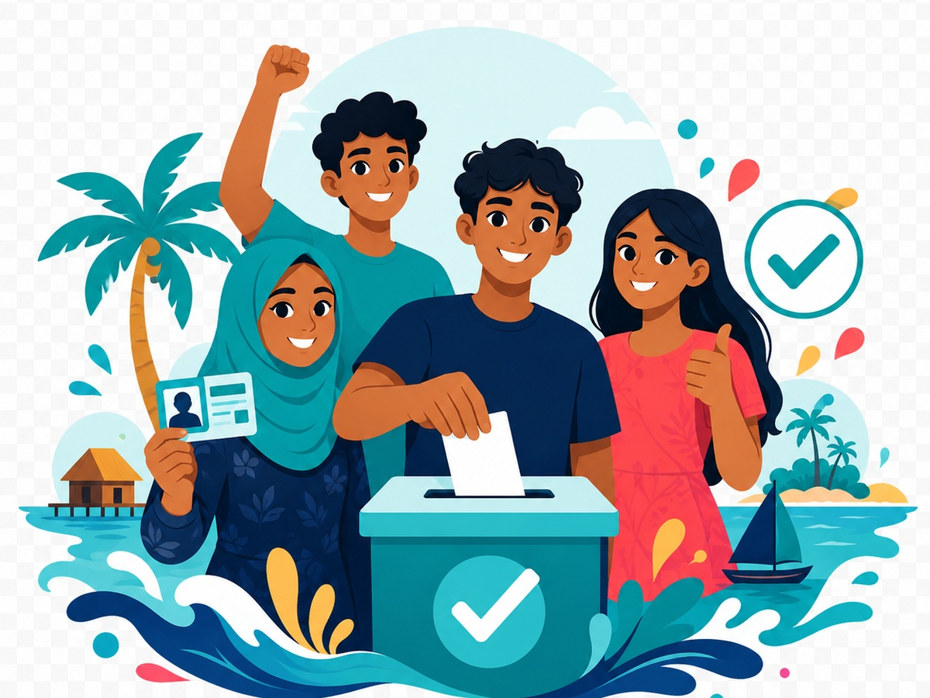
Implemented by:
In partnership with:
Women & Democracy
QUIZ 7
By-elections in the Maldives
Vacant Seats and Voter Participation Quiz
Understand what by-elections are, why they matter, and how voters can participate responsibly.
#rights
#verify
#vote
#youth
Maldives Election Awareness
Swipe-style PPT deck for youth civic education sessions
W&D Election Awareness Hub • Quiz 7
1

Slide 2
By-elections in the Maldives
Implemented by:
In partnership with:
Women & Democracy
How to play
A quick, interactive quiz designed for youth sessions, community forums, and website engagement.
1
Read each question and choose A, B, C or D.
2
Use this quiz to explain why by-elections matter even when they are smaller than national elections.
8–10
Excellent
3
For official dates, voter lists, candidates and results, always refer to the Elections Commission of Maldives.
5–7
Good effort
0–4
Keep learning
Tip: encourage discussion after each answer.
W&D Election Awareness Hub • Quiz 7
2

Slide 3
Vacant Seats and Voter Participation Quiz
Implemented by:
In partnership with:
Women & Democracy
Q1
What is a by-election?
A
An election held to fill a vacant seat before the next general election
B
A social media poll
C
A campaign rally
D
A voter registration form
Prepare early. Vote peacefully.
Maldives context
Discuss with your group
A by-election is held when a seat becomes vacant and voters need to choose a replacement representative.
W&D Election Awareness Hub • Quiz 7
3

Slide 4
Vacant Seats and Voter Participation Quiz
Implemented by:
In partnership with:
Women & Democracy
Q2
Who supervises and conducts elections in the Maldives under the Elections (General) Act?
A
Elections Commission of Maldives
B
Private media companies
C
Candidates themselves
D
Island shops
Prepare early. Vote peacefully.
Maldives context
Discuss with your group
The Elections Commission is responsible for conducting and supervising elections under the Elections (General) Act.
W&D Election Awareness Hub • Quiz 7
4

Slide 5
Vacant Seats and Voter Participation Quiz
Implemented by:
In partnership with:
Women & Democracy
Q3
Why do by-elections matter?
A
They help communities fill vacant representation
B
They are only entertainment
C
They cancel voter rights
D
They replace all regular elections
Prepare early. Vote peacefully.
Maldives context
Discuss with your group
By-elections help ensure communities continue to have representation when a seat becomes vacant.
W&D Election Awareness Hub • Quiz 7
5

Slide 6
Vacant Seats and Voter Participation Quiz
Implemented by:
In partnership with:
Women & Democracy
Q4
For local council vacancies covered by the 12th Amendment, who must notify the Elections Commission?
A
Local Government Authority
B
Only candidates
C
Only voters
D
Foreign observers
Prepare early. Vote peacefully.
Maldives context
Discuss with your group
The 12th Amendment requires LGA to notify the Elections Commission of specified council vacancies.
W&D Election Awareness Hub • Quiz 7
6

Slide 7
Vacant Seats and Voter Participation Quiz
Implemented by:
In partnership with:
Women & Democracy
Q5
Within how many days must LGA notify the Elections Commission of certain local council vacancies?
A
14 days
B
60 days
C
183 days
D
365 days
Prepare early. Vote peacefully.
Maldives context
Discuss with your group
The 12th Amendment states that LGA must notify the Elections Commission within 14 days of specified vacancies.
W&D Election Awareness Hub • Quiz 7
7

Slide 8
Vacant Seats and Voter Participation Quiz
Implemented by:
In partnership with:
Women & Democracy
Q6
After LGA notification, within what period must the Elections Commission schedule a by-election for specified council vacancies?
A
Within 183 days
B
Within 10 years
C
Only after the next presidential election
D
Never
Prepare early. Vote peacefully.
Maldives context
Discuss with your group
The 12th Amendment says the Elections Commission must schedule a by-election within 183 days after LGA notification, subject to exceptions.
W&D Election Awareness Hub • Quiz 7
8

Slide 9
Vacant Seats and Voter Participation Quiz
Implemented by:
In partnership with:
Women & Democracy
Q7
When is a local council by-election not mandatory under the 12th Amendment?
A
When the remaining council term is 365 days or less
B
Whenever turnout is low
C
If the seat is in an island
D
If people discuss it online
Prepare early. Vote peacefully.
Maldives context
Discuss with your group
A by-election is not mandatory if the remaining term of the council is 365 days or less at the time of vacancy.
W&D Election Awareness Hub • Quiz 7
9

Slide 10
Vacant Seats and Voter Participation Quiz
Implemented by:
In partnership with:
Women & Democracy
Q8
What must voters check before a by-election?
A
Official voter registry and polling information
B
Only memes
C
Only forwarded messages
D
Only campaign rumours
Prepare early. Vote peacefully.
Maldives context
Discuss with your group
Voters should check official voter registry and polling information, especially because by-elections can be more localised.
W&D Election Awareness Hub • Quiz 7
10

Slide 11
Vacant Seats and Voter Participation Quiz
Implemented by:
In partnership with:
Women & Democracy
Q9
Who can raise election-related complaints under the Elections (General) Act?
A
Eligible voters, candidates, political parties, approved observers/monitors and election officials
B
Only famous people
C
Only social media pages
D
No one
Prepare early. Vote peacefully.
Maldives context
Discuss with your group
The Elections (General) Act allows eligible voters, candidates, political parties, approved observers/monitors and election officials to raise complaints.
W&D Election Awareness Hub • Quiz 7
11

Slide 12
Vacant Seats and Voter Participation Quiz
Implemented by:
In partnership with:
Women & Democracy
Q10
What is the best message for by-election voters?
A
Small election, big voice
B
My vote does not matter
C
Rumours are enough
D
Only national elections count
Prepare early. Vote peacefully.
Maldives context
Discuss with your group
By-elections may be smaller, but they can directly affect local representation and community decisions.
W&D Election Awareness Hub • Quiz 7
12

Slide 13
By-elections in the Maldives
Implemented by:
In partnership with:
Women & Democracy
Answer Key
Reveal answers after participants complete the quiz.
Q1
Q2
Q3
Q4
Q5
A
A
A
A
A
Q6
Q7
Q8
Q9
Q10
A
A
A
A
A
8–10: Strong awareness
5–7: Review key points
Facilitator prompt: Ask participants which answer surprised them most and why.
0–4: Keep learning
W&D Election Awareness Hub • Quiz 7
13

Slide 14
By-elections in the Maldives
Implemented by:
In partnership with:
Women & Democracy
Legal references
Use these references to keep the quiz grounded in Maldivian election law and official civic education sources.
✓
Elections (General) Act, Law No. 11/2008
✓
Decentralisation Act of Maldives, Law No. 07/2010
✓
President’s Office: 12th Amendment to the Decentralisation Act, 18 August 2024
✓
Elections Commission of Maldives: election information and voter registry
Know your rights. Check the source.
Disclaimer: This is for civic and voter education only. For official election dates, voter registration, polling locations, candidate lists, complaints, and results, refer to the Elections Commission of Maldives.
W&D Election Awareness Hub • Quiz 7
14

Slide 15
Implemented by:
In partnership with:
Women & Democracy
End of Quiz
Thank you for participating
Keep checking official sources, protect your vote, and help your community participate freely and responsibly.
Check before you share
My vote matters
W&D Election Awareness Hub
W&D Election Awareness Hub • Quiz 7
15

